Slide 1
Enacting Distributed HPC Workflows: Opportunities and Challenges
Feb 20-21, 2025, UCR and UCI
Ketan Maheshwari
NCCS / OLCF, Oak Ridge National Laboratory

Slide 2
Acknowledgements
Thanks to Profs. Tsotras (UCR), Eldawy (UCR), Li (UCI), Jahangiri (SCU) for the invites and organization.
Thanks for the support at UCR: Gerardo and UCI: Jamie
The work presented used resources of the Oak Ridge Leadership Computing Facility at the Oak Ridge National Laboratory, which is supported by the Office of Science of the U.S. Department of Energy under Contract No. DE-AC05-00OR22725
Thanks to colleagues at Oak Ridge and many collaborators who have contributed and enriched the work presented.

Slide 3
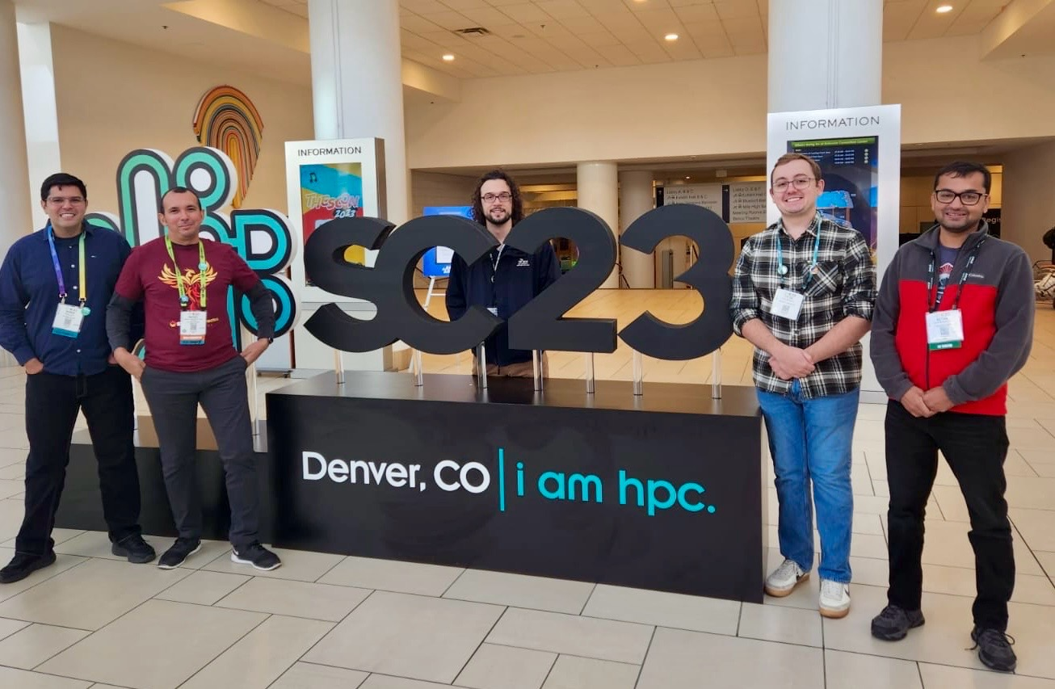
About me
Senior Engineer
Part of the NCCS Division / OLCF Program
Workflows and Ecosystem Services: Fast growing group of 9 as of 1/2025
Specialize in Science Workflows
Interested in HPC-Science applications, porting, deployment and troubleshooting aspects
Postdoc at Argonne National Laboratory and Cornell
PhD in Scientific Workflows area, Univ of Nice, France

Slide 4
Overview
Context: The DOE Complex
Workflows: What, Why, How, State of the art
The Various Aspects of Workflows
Representation and UI / UX
Data
Parallelism
Scheduling
Distributed Workflows
Opportunities : Leveraging DOE Capacities and Capabilities
Challenges : Technical, Technological, Social / Cultural

Slide 5
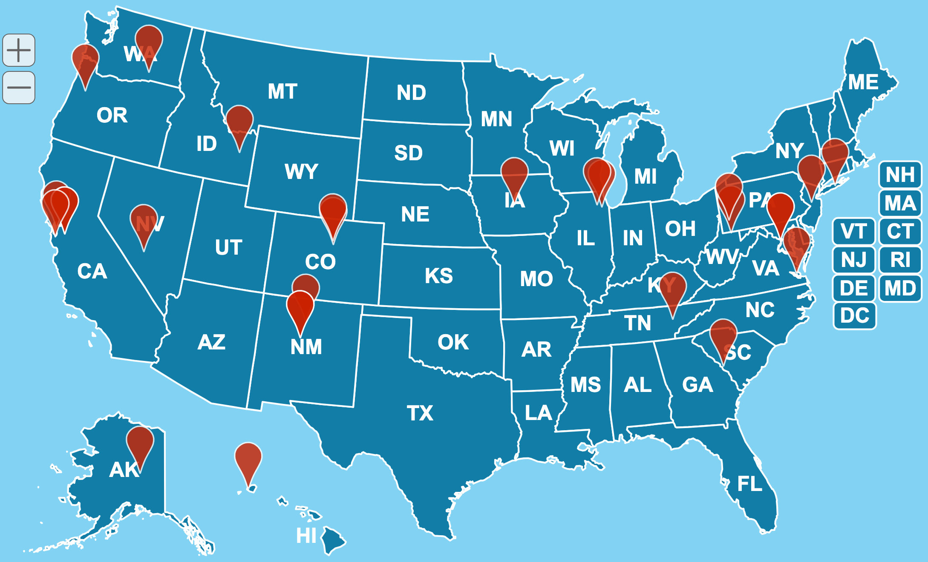
The Department of Energy (DOE) Complex: Seventeen Laboratories across the nation, a variety of Facilities
Geographically and administratively distributed
Data Producing Facilities such as APS, SNS
Data Producing Field Research such as Transportation and BioSciences research
Data Processing Facilities such as OLCF, ALCF, NERSC
Projects allocated to wider community including Universities and commercial entities

Slide 6
Thank You for your time! Questions?
maheshwarikc@ornl.gov

